Slide 1
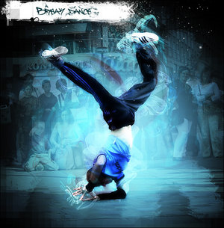
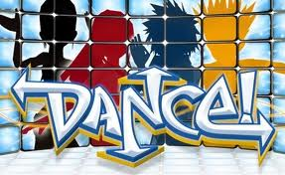
My favourite hobby
Javoríková Miroslava 9.A

Slide 2
Dance is an art form that generally refers to movement of the body, usually rhythmic and to music, used as a form of expression, social interaction or presented in a spiritual or performance setting.
Dance may also be regarded as a form of nonverbal communication between humans, and is also performed by other animals. Gymnastics, figure skating and synchronized swimming are sports that incorporate dance, while martial arts kata are often compared to dances.

Slide 3
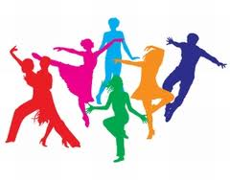
I love dance because:
Dance is one of my favorite hobby because I can do it to express their feelings. For example, when I feel sad and I start dancing, now I go to other ideas and makes me better. When dancing, I feel more confident.

Slide 4
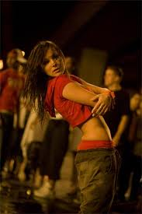
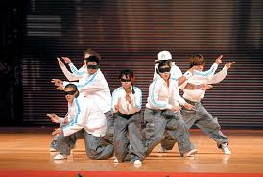
Hip Hop
Hip-hop dance refers to dance styles primarily danced to hip-hop music or that have evolved as part of hip-hop culture. This includes a wide range of styles notably breaking, locking, and popping which were developed in the 1970s by Black and Latino Americans. What separates hip-hop dance from other forms of dance is that it is often freestyle (improvisational) in nature and hip-hop dancers frequently engage in battles—formal or informal freestyle dance competitions. Informal freestyle sessions and battles are usually performed in a cipher, "a circular dance space that forms naturally once the dancing begins." These three elements—freestyling, battles, and ciphers—are key components of hip-hop dance.

Slide 5
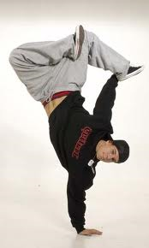
Break Dance
The concept of break dance or breakdance identifies several forms of dance that arose between the African-American and Puerto Rican youth in the U.S. in the 70 the 20th century. It is characterized by acrobatic acts.
Break dance is a young form of escape from the stereotypical life of an anonymous city. The emergence and development of this dance is inextricably linked to the subculture of hip-hop. Among the most breakers group includes Rock Steady Crew, New York City Breakers and South Side Rockers.

Slide 6
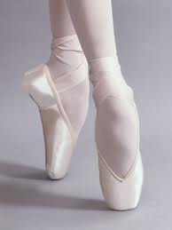
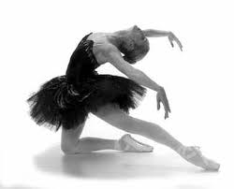
Ballet
Ballet is an artistic unit, uniting music, libretto, choreography, scenery and costumes. Ballet may be a single work, or be part of the opera, or operetta.
In the 18th century has been the popularization of the ballet, which led to the development and improvement of ballet technique. Ballet gradually became equal by the dramatic form. On the development of the ballet had a major impact issue Lettres sur la danse et les ballets, thanks to which there is a complete pantomime as well as enforcing the reform movement, which raised the possibility to express a story.

Slide 7
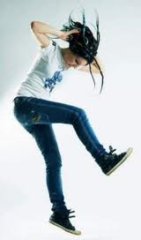
DnB step
This dance is linked to many musical styles 2step, who was born around the year 1998 in London clubs. Interest grew, people had enough of accelerated music and wanted something else. This resulted in slow speed garage and formation 2stepu. The combination of house, breakbeat accompanied by "treading cabbage". Rhythm accelerates and gradually slows down again. Originally, this style was only attributed to feminine interest. However, the age of equality and everything new is appealing, so it was only a matter of time before it embraced the macho part of the company.

Slide 8
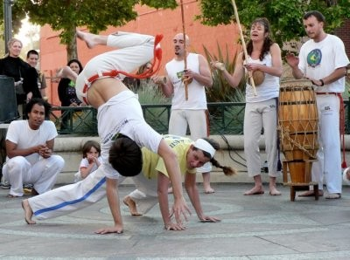
Capoeira
Capoeira is a Brazilian martial dance. There are movements of dance mixed fight. It is now considered a combat sport with fixed rules. It is said that the modern form of capoeira allegedly evolved from breakdancing in the Bronx U.S.

Slide 9
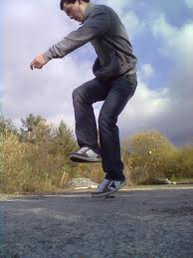
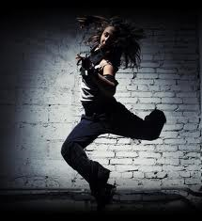
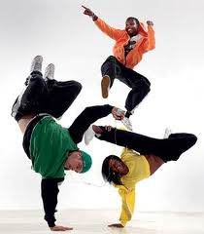
My view of the dance
I love dancing, because people can relax and move to a completely different idea. I think that at this time, many generations to dance to their style and view of the world.
My favorite is hip hop.

Slide 10
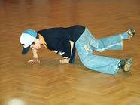
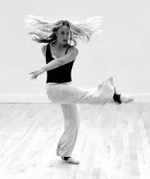
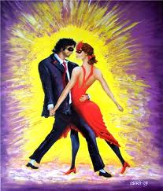
Thank´s for watching.

